Slide 1

Web Application Development
COMP-229
Fall 2023

Slide 2
COMPONENTS
A Component is one of the core building blocks of React.
We can say that every application you will develop in React will be made up of pieces called components.
Components make the task of building UIs much easier.
You can see a UI broken down into multiple individual pieces called components and work on them independently and merge them all in a parent component which will be your final UI.
Components in React basically return a piece of JSX code that tells what should be rendered on the screen.

Slide 3
Types of components in ReactJS
In React, we mainly have two types of components:
Functional Components: Functional components are simply Javascript functions.
We can create a functional component in React by writing a Javascript function.
These functions may or may not receive data as parameters,

Slide 4
The below example shows a valid functional component in React:
function demoComponent() { return (<h1> Welcome Message! </h1>); }

Slide 5
Class Components: The class components are a little more complex than the functional components.
The functional components are not aware of the other components in your program whereas the class components can work with each other.
We can pass data from one class component to another class component.
We can use JavaScript ES6 classes to create class-based components in React.

Slide 6
The below example shows a valid class-based component in React:
class Democomponent extends React.Component { render() { return <h1>Welcome Message!</h1>; } }

Slide 7
Rendering Components in ReactJS
const elementName = <ComponentName />;
React is also capable of rendering user-defined components.
To render a component in React we can initialize an element with a user-defined component and pass this element as the first parameter to ReactDOM.render() or directly pass the component as the first argument to the ReactDOM.render() method.
The below syntax shows how to initialize a component to an element:
const elementName = <ComponentName />;

Slide 8
In the above syntax, the ComponentName is the name of the user-defined component.
Note: The name of a component should always start with a capital letter. This is done to differentiate a component tag from HTML tags.
The below example renders a component named Welcome to the Screen:

Slide 9
create-react-app

Slide 10
A pretty amazing tool to have at your disposal as a React developer is Create React App, a command-line tool that autogenerates a React project.
create-react-app was inspired by the Ember CLI project, and it lets developers get started with React projects quickly without the manual configuration of webpack, Babel, ESLint, and associated tools.

Slide 11
Create a folder in vscode or create a folder and open it in vscode
At the terminal in your vscode,
To get started with create-react-app, install the package globally with the following command:
npm install -g create-react-app
Then, use the command and the name of the folder where you’d like the app to be created:
create-react-app my-react-app

Slide 12
NPX
You can also use npx to run create-react-app without the need for a global install. Simply run
npx create-react-app my-react-app

Slide 13
This will create a React project in that directory with just three dependencies: React, ReactDOM, and react-scripts.
react-scripts was also created by Facebook and is where the real magic happens.
It installs Babel, ESLint, webpack, and more, so that you don’t have to configure them manually. Within the generated project folder,
you’ll also find a src folder containing an App.js file. Here, you can edit the root component and import other component files.

Slide 14
From within the my-react-project folder, you can run npm start.
If you prefer, you can also run yarn start.
This will start your application on port 3000.

Slide 15
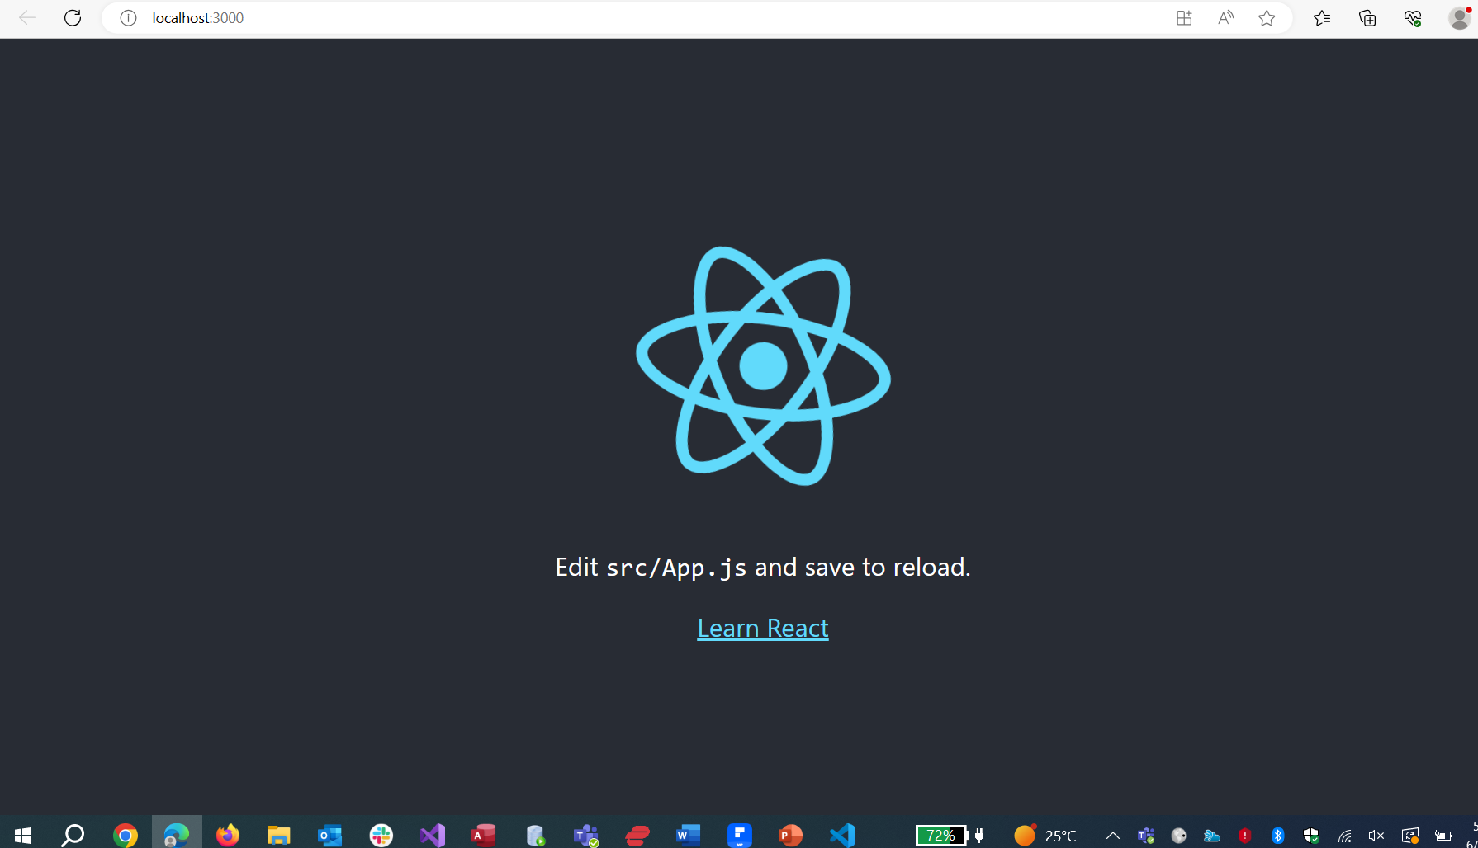

Slide 16
You can run tests with npm test or yarn test.
This runs all of the test files in the project in an interactive mode.
You can also run the npm run build command. Using yarn, run yarn build.
This will create a production-ready bundle that has been transformed and minified.

Slide 17
create-react-app is a great tool for beginners and experienced React developers alike.
As the tool evolves, more functionality will likely be added, so you can keep an eye on the changes on GitHub.

Slide 18
Navigate to the App.js file replace the existing code with the following code:

Slide 19
import React from 'react';
import ReactDOM from 'react-dom';
// This is a functional component
const Welcome = () => {
return <h1>Hello World!</h1>;
}
ReactDOM.render(
<Welcome />, // Use <Welcome /> instead of <welcome>
document.getElementById("root")
);
export default Welcome;

Slide 20
Navigate to the src/index.js file replace the existing code with the following code:
import React from 'react';
import ReactDOM from 'react-dom/client';
//import './index.css';
import App from './App';
//import reportWebVitals from './reportWebVitals';
const root = ReactDOM.createRoot(document.getElementById('root'));
root.render(
<React.StrictMode>
<App />
</React.StrictMode>
);

Slide 21
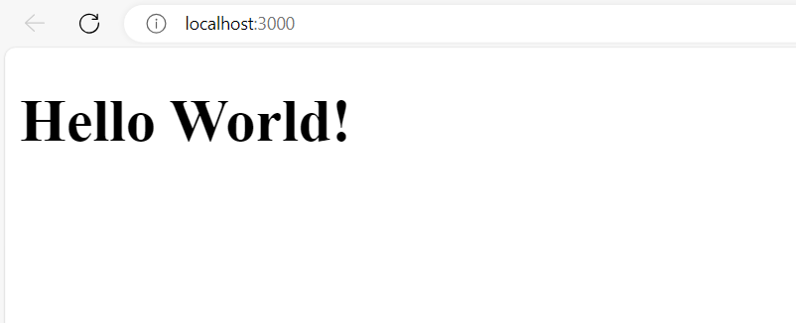
At the terminal run your code with the following command:
npm start
Output is as follows:

Slide 22
Let us see step-wise what is happening in the above example:
We call the ReactDOM.render() as the first parameter.
React then calls the component Welcome, which returns <h1>Hello World!</h1>; as the result.
Then the ReactDOM efficiently updates the DOM to match with the returned element and renders that element to the DOM element with id as “root”.

Slide 23
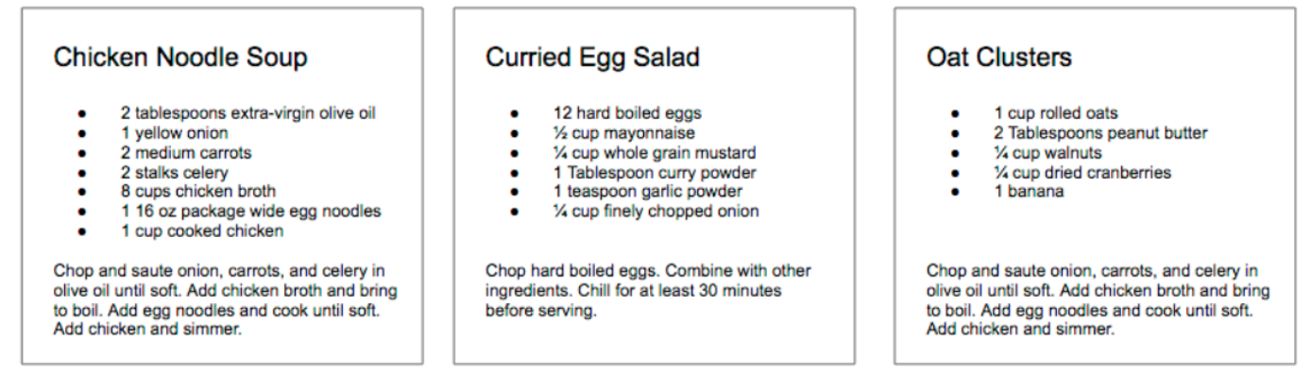
React Component contd.
No matter its size, its contents, or what technologies are used to create it, a user interface is made up of parts. Buttons. Lists. Headings. All of these parts, when put together, make up a user interface.
Consider a recipe application with three different recipes. The data is different in each box, but the parts needed to create a recipe are the same.

Slide 24
In React, we describe each of these parts as a component.
Components allow us to reuse the same structure and then we can populate those structures with different sets of data.
When considering a user interface that you want to build with React, look for opportunities to break down your elements into reusable pieces.
For example, the recipes in each have a title, ingredients list, and instructions. All are part of a larger recipe or app component. We could create a component for each of the highlighted parts: ingredients, instructions, and so on.

Slide 25
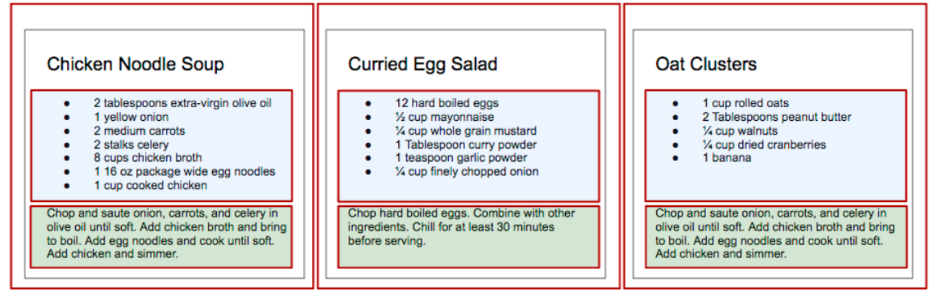

Slide 26
Each component is outlined: App, IngredientsList
We’ll create a component by writing a function. That function will return a reusable part of a user interface.
EXAMPLE I
Let’s create a function that returns an unordered list of ingredients dessert with a function called IngredientsList

Slide 27
Modify the App.js in the existing application(Hello World) as follows i.e replace with the following code:
import React from 'react';
import ReactDOM from 'react-dom';
function IngredientsList() {
return React.createElement(
"ul",
{ className: "ingredients" },
React.createElement("li", null, "1 cup unsalted butter"),
React.createElement("li", null, "1 cup crunchy peanut butter"),
React.createElement("li", null, "1 cup brown sugar"),
React.createElement("li", null, "1 cup white sugar"),
React.createElement("li", null, "2 eggs"),
React.createElement("li", null, "2.5 cups all purpose flour"),
React.createElement("li", null, "1 teaspoon baking powder"),
React.createElement("li", null, "0.5 teaspoon salt")
);
}
ReactDOM.render(
React.createElement(IngredientsList, null, null),
document.getElementById("root")
);
export default IngredientsList;

Slide 28
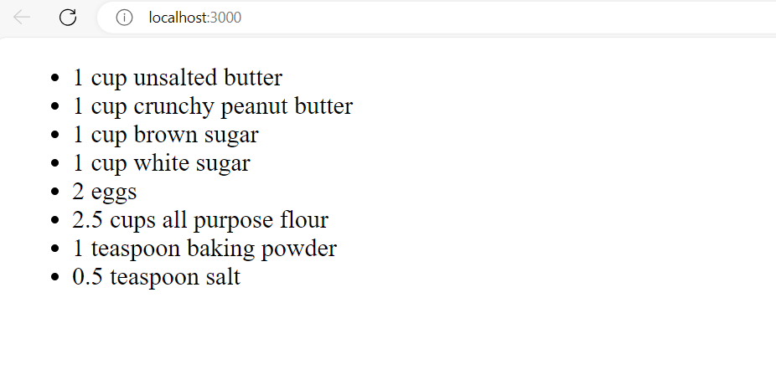

Slide 29
we’ve hardcoded this data into the component.
What if we could build one component and then we could pass data into that component as properties? And then what if that component could render the data dynamically? Here’s an array of items needed to put together a recipe:
code
const items = [ "1 cup unsalted butter", "1 cup crunchy peanut butter", "1 cup brown sugar", "1 cup white sugar", "2 eggs", "2.5 cups all purpose flour", "1 teaspoon baking powder", "0.5 teaspoon salt" ];

Slide 30
Then we’ll adjust the IngredientsList component to map over these items, constructing a li for however many items are in the items array:
code
function IngredientsList() { return React.createElement( "ul", { className: "ingredients" }, items.map((ingredient, i) => React.createElement("li", { key: i }, ingredient) ) ); }

Slide 31
Then we’ll pass those items as the second property of the createElement call in ReactDOM.render:
code
ReactDOM.render( React.createElement(IngredientsList, { items }, null), document.getElementById("root") );

Slide 32
Updated App.js file.
import React from 'react';
import ReactDOM from 'react-dom';
const items = [
"1 cup unsalted butter",
"1 cup crunchy peanut butter",
"1 cup brown sugar",
"1 cup white sugar",
"2 eggs",
"2.5 cups all purpose flour",
"1 teaspoon baking powder",
"0.5 teaspoon salt"
];
function IngredientsList() {
return React.createElement("ul", { className: "ingredients" }, items.map((ingredient, i) => React.createElement("li", { key: i }, ingredient)));
}
ReactDOM.render(
React.createElement(IngredientsList, { items }, null),
document.getElementById("root")
);
export default IngredientsList;

Slide 33
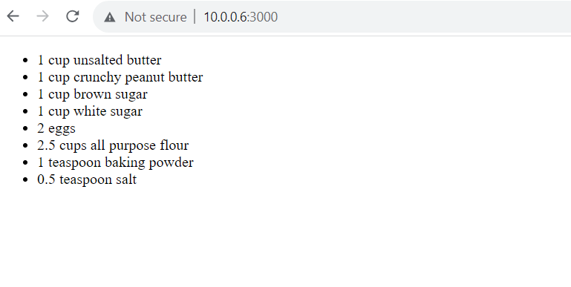
Output

Slide 34
Looking at the DOM. The data property items is an array with eight ingredients. Because we made the li tags using a loop, we were able to add a unique key using the index of the loop:
code
<IngredientsList items="[...]"> <ul className="ingredients"> <li key="0">1 cup unsalted butter</li> <li key="1">1 cup crunchy peanut butter</li> <li key="2">1 cup brown sugar</li> <li key="3">1 cup white sugar</li> <li key="4">2 eggs</li> <li key="5">2.5 cups all purpose flour</li> <li key="6">1 teaspoon baking powder</li> <li key="7">0.5 teaspoon salt</li> </ul> </IngredientsList>

Slide 35
Creating our component this way will make the component more flexible.
Whether the items array is 1 item or 100 items long, the component will render each as a list item.
Another adjustment we can make here to reference the items array from React props.
Instead of mapping over the global items, we will make items available on the props object.
Start by passing props to the function then mapping over props.items:

Slide 36
code
function IngredientsList(props) { return React.createElement( "ul", { className: "ingredients" }, props.items.map((ingredient, i) => React.createElement("li", { key: i }, ingredient) ) ); }

Slide 37
Updated App.js
import React from 'react';
//import ReactDOM from 'react-dom';
function IngredientsList(props){
return React.createElement(
"ul",
{className: "ingredients" },
props.items.map((ingredient, i) =>
React.createElement("li", {key: i }, ingredient)
)
);
}
export default IngredientsList;

Slide 38
Updated index.js
import React from 'react';
import ReactDOM from 'react-dom/client';
//import './index.css';
import App from './App';
//import reportWebVitals from './reportWebVitals';
const root = ReactDOM.createRoot(document.getElementById('root'));
const items = [
"1 cup unsalted butter",
"1 cup crunchy peanut butter",
"1 cup brown sugar",
"1 cup white sugar",
"2 eggs",
"2.5 cups all purpose flour",
"1 teaspoon baking powder",
"0.5 teaspoon salt"
];
root.render(
<React.StrictMode>
<App items={items} />
</React.StrictMode>
);

Slide 39
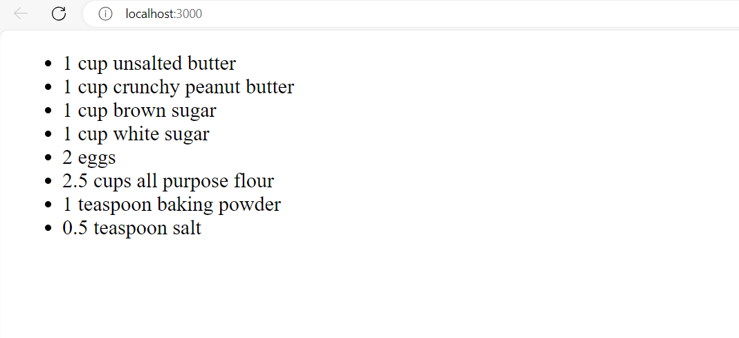

Slide 40
We could also clean up the code a bit by destructuring items from props:

Slide 41
Updated App.js
import React from 'react';
//import ReactDOM from 'react-dom';
function IngredientsList({ items }) {
return React.createElement(
"ul",
{ className: "ingredients" },
items.map((ingredient, i) =>
React.createElement("li", { key: i }, ingredient)
)
);
}
export default IngredientsList;

Slide 42
Updated index.js
import React from 'react';
import ReactDOM from 'react-dom/client';
//import './index.css';
import App from './App';
//import reportWebVitals from './reportWebVitals';
const root = ReactDOM.createRoot(document.getElementById('root'));
const items = [
"1 cup unsalted butter",
"1 cup crunchy peanut butter",
"1 cup brown sugar",
"1 cup white sugar",
"2 eggs",
"2.5 cups all purpose flour",
"1 teaspoon baking powder",
"0.5 teaspoon salt"
];
root.render(
<React.StrictMode>
<App items={items} />
</React.StrictMode>
);

Slide 43
